Slide 1
Putting Geodemographics to Work: The Nitty Gritty of Social Research
Lee Fiorio, University of Washington, Geography

Slide 2
A QUESTION
What is the difference between a census and a sample?

Slide 3
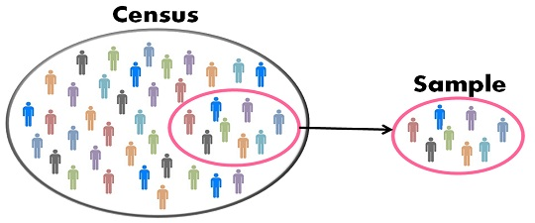
CENSUS VS. SAMPLE
Census
A collection of complete information from all members of a population
Sample
A subsection of a population that is used to infer characteristics of the population
Image source: keydifferences.com

Slide 4
CENSUS VS. SAMPLE: SOME FOLLOW-UPS
Which is more economical?
Which is more accurate?
Which would a statistician prefer?
Samples allow for the quantification of uncertainty
Which would a computer scientist prefer?
Censuses allow for the analysis of more nuanced trends

Slide 5
ABOUT ME
Originally from the Chicago area
Attended McGill University in Montréal, Canada from 2005 to 2009
Majored in Geography
Minors in Economics and Statistics
Wrote an honors thesis on the changing geographic distribution of different ethnic groups in Canada, 1901 to 2001

Slide 6

ABOUT ME

Slide 7
ABOUT ME
Moved back to Chicago
Interviewed at company called NORC
Was hired as a “Research Assistant” in the Statistics Department (Fall 2009)
Ended up working at NORC for almost 5 years (until Summer of 2014)

Slide 8

What is NORC at the University of Chicago?
NORC at the University of Chicago is an independent, non-profit research institution…
...“that delivers reliable data and rigorous analysis to guide critical programmatic, business, and policy decisions.”
Five main research areas:
Economics, Markets, and the Workforce
Education, Training, and Learning
Global Development
Health and Well-Being
Society, Media, and Public Affairs.

Slide 9
But what is NORC at the University of Chicago really?
What do they do?
Mostly data collection, some analysis
How do they do it?
Mostly survey research – generating statistical estimates by conducting interviews on a sample of a survey population
For whom?
Government agencies, academic researchers, philanthropic organizations, to some extent businesses
Why?
It really depends!
(Caveat: this is all based on my years working there ’09-’14)

Slide 10
A brief but illuminating history of early NORC
Founded in 1941 by Harry H Field as an affiliate of the University of Denver
Harry Field had worked under survey research pioneers Gallup, Roper and Crossley
Field was interested in using scientifically rigorous methods to conduct surveys in the public interest
Not market research or election forecasts...
But surveys “that would attempt to give the people a voice in political, social and economic decision-making”
Offered at cost services to educators and academics
Dedicated to improving survey research methods

Slide 11
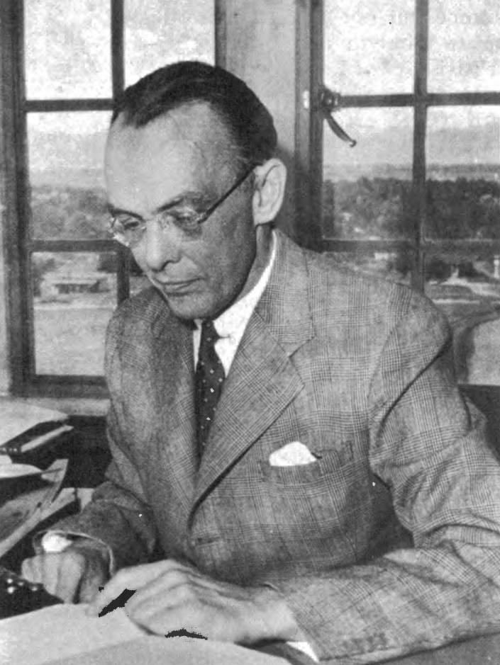
A little early history… continued
Harry Field died in a plane crash in 1946
NORC relocated to Chicago in 1947
Research capability restructured and expanded
Shift towards government research contracts

Slide 12
“Geodemographics” and the Governing of Democratic Societies
Decennial Censuses are mandated by Article I, Section 2 of the US Constitution:
Representatives and direct Taxes shall be apportioned among the several States which may be included within this Union, according to their respective Numbers, which shall be determined by adding to the whole Number of free Persons, including those bound to Service for a Term of Years, and excluding Indians not taxed, three fifths of all other Persons. The actual Enumeration shall be made within three Years after the first Meeting of the Congress of the United States, and within every subsequent Term of ten Years, in such Manner as they shall by Law direct. The Number of Representatives shall not exceed one for every thirty Thousand, but each State shall have at Least one Representative…

Slide 13
“Geodemographics” and the Governing of Democratic Societies
WHAT IS KNOWABLE
WHAT IS KNOWABLE VIA SURVEY RESEARCH METHODS
WHAT THE GOV. (AKA: WE, THE PEOPLE) WANT TO KNOW
? ? ? ? ? ?
? ? ? ? ? ?
? ? ? ? ? ?
WHAT GOV. IS MANDATED TO KNOW

Slide 14
Other Survey Research Organizations

Slide 15
Example NORC Studies
General Social Survey (GSS)
1972 to the present
Follows social change and the complexity of American society
Second most frequently analyzed source of information for the social sciences in the US
Funded by the National Science Foundation

Slide 16
Example NORC Studies (GSS)

Slide 17
Example NORC Studies (GSS)

Slide 18
Example NORC Studies
National Immunization Survey (NIS)
1994 to the present
Provides important statistics about childhood immunization
Funded by the Centers for Disease Control

Slide 19
Example NORC Studies
National Longitudinal Survey of Youth (NLSY)
1966 to the present
Collects data on the economic, social and academic experiences of a cohort of subjects
Focus on issues related to youth entry into the workforce
Funded by the US Dept of Labor and Bureau of Labor Statistics

Slide 20
Example NORC Studies
Survey of Consumer Finances (SCF)
1992 to the present
Collects information on household financial characteristics and behavior
Funded by the Federal Reserve Board

Slide 21
Example NORC Studies (SCF)

Slide 22
So…what did I, a geographer, do at NORC?

Slide 23
Let’s go back to the question of census vs. sample
Depending on how you look at it, it’s kind of a trick question
A census is a enumeration of an entire population
A sample is a subset of a population used to draw inference about a larger population
However, drawing a representative sample typically requires some prior knowledge about the population
…and in most cases, researchers need a sampling frame to select a sample

Slide 24
Two approaches to dealing with representativeness
Stratification
The process of dividing members of a population into homogeneous, mutually exclusive subgroups before sampling
IMPORTANT: this is different than “quota sampling”
Weighting
The process of counting survey responses differently by subgroup to adjust for likely biases
Question: what categories should survey researchers use to assure representativeness of their results?
Does it depend on the purpose of the survey?

Slide 25
Geodemographics are fundamental!
Data collected by the federal government via the Census and American Community Survey (ACS) constitute the backbone of our prior knowledge
They allow the quantification of uncertainty in survey estimates by providing wide-scale picture of what we might call ‘the ground truth’
Example: if our survey is of the city of Seattle and ACS says ~ 50% of individuals make less than $40k/year and in our sample, <30% of individuals make less than $40k/year, then we need to consider the representativeness of our data

Slide 26
Geodemographics are fundamental!
Geography matters
Where somebody lives often says a lot about them
The “homogenous subgroups” (e.g. race) that one might use for stratification are often not homogenous across space
Timely example: a 50 year old white man living in Akron, OH is likely to have voted differently from a 50 year old white man living in Wallingford
Ensuring geographic coverage in a survey adds cost

Slide 27
So, again…what did I, a geographer, do at NORC?

Slide 28
Sampling Frames
In the 1970s and 1980s, survey research was in its golden era
The prevalence of landline telephones and willingness of people to respond to surveys made surveys fairly cheap and representative

Slide 29
Random Digit Dialing (RDD)

Slide 30
The demise of RDD
The unrooted nature of cell phones makes them difficult to link to a single geographic location
People have become less willing to respond to telephone surveys

Slide 31
Address-Based Sampling
Sampling addresses then individuals within the addresses
Allows for stratification by area
Linking address to telephone number allows for a multi-modal approach to conducting interviews
Via telephone (cheapest)
Via mail (also pretty cheap)
In person (as a last resort)
But where does one get a sampling frame of addresses?

Slide 32
Old school listing

Slide 33
Licensing address lists
United States Postal Service maintains a master list of addresses
US Census uses this list to help conduct censuses
Prohibited from selling the list outright, but will for a price “correct” any list that is mostly accurate
Coupon companies now license address lists to survey research organizations
Assuring quality of these lists and geocoding is key to their effective use in survey research

Slide 34
What goes into survey research?
Designing and implementing sampling strategies
Creating questionnaires
Conducting Interviews
Training Interviewers
Monitoring data collection effort (response rates, costs per complete, and so on)
Cleaning data and assigning proper weights
Delivering data
Competing for contracts
Hiring people

Slide 35
Where might error creep in?
The Total Survey Error Approach

Slide 36
So using this chart as a guide, let’s try to answer:
How might the election polls (in WI, MI and PA) have gone wrong?

Slide 37
Current State of Survey Research
It seems old fashioned
It is old fashioned
But it also remains the gold standard in (quantitative) social science research
On the other hand, there’s growing amounts of “ambient” data that might be able to replace survey research
Perhaps an argument could be made from a measurement perspective that it’s better not to ask anyone anything, if you can avoid it

Slide 38
Trust and Paranoia
People are increasingly worried about privacy and confidentiality
But are survey research organizations the proper target?
Maybe!
I personally don’t think so:
Market research organizations, credit rating agencies, background check companies all compile and sell information about individuals and households

Slide 39
Big Data: Panacea or Diversion?
There’s a lot of hype
But issues about representation and measurement remain prevalent
Some of my work in graduate school explores the possibility of using certain kinds of social media data for generating demographic (geodemographic) estimates

Slide 40
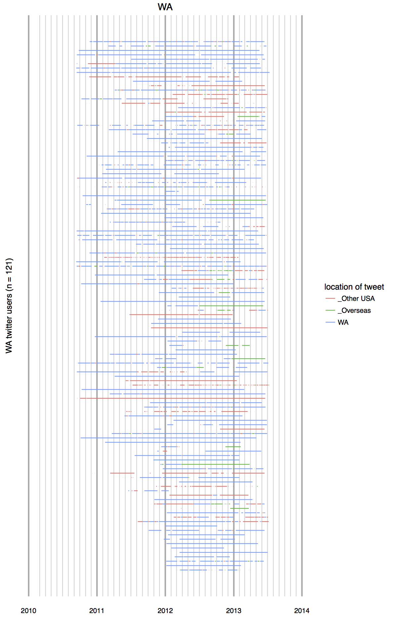
Using geo-tagged tweets to estimate internal migration

Slide 41
Using geo-tagged tweets to estimate internal migration

Slide 42
The parable of Google Flu
The purpose was to link search terms with CDC-estimated rates of flu to produce more timely estimates of rates of flu
The trouble was separating key terms that were related to the flu and those that were simply related to the seasonality of the flu (e.g high school basketball)
Google Flu Trends missed non-seasonal H1N1 outbreak

Slide 43
The parable of Google Flu (cont’d)
Relied on the assumption that search volume is associated with phenomenon of interest (ie having the flu)
But ignored the ways in which search behavior is manipulated by Google, especially via advertising and search algorithm tweaking

Slide 44
Final Question(s):
What are some questions that you think could reliably be answered using ‘big data’/social media data? Why?
What are some questions that you think could NOT reliably be answered using ‘big data’/social media data? Why?
How and why might the balance between these two realms shift over time?

Slide 45
Feel free to email me and questions
Lee Fiorio
fiorio@uw.edu

